Slide 1
Schistosoma Parasites
Called Blood Flukes
Adult Flukes live in blood vessels of infected Humans
S.haematobium
S.mansoni
S.japonicum
D.H: Man
R.H: None
D.H: Man
R.H: Rodent, Monkeys
D.H: Man
R.H: Domestic animals

Slide 2
Definitive Host
Man
Habitat
Blood vessels
Inferior mesenteric plexus of veins
Superior & Inferior mesenteric plexus of veins
Where adult S.mansoni live
Where adult S.japonicum live

Slide 3
Schistosoma differs from other trematodes in:
Has separate sexes.
Lives in blood.
Has non-operculated eggs.
Has no Redia stage.
Has no encysted metacercaria.
Common species affecting man:
S. mansoni, S. haematobium,
S. japonicum, S. intercalatum and
S. mekongi.

Slide 4
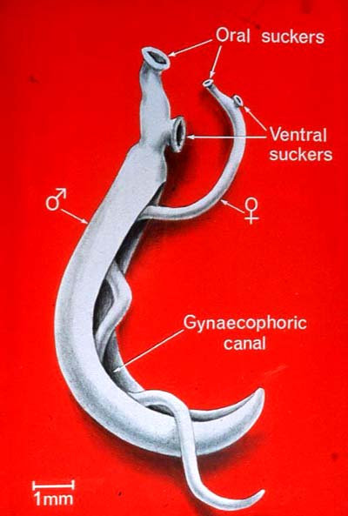
Adult Morphology
Sexes: separate
Female: cylindrical
Male: flattened, folded (gynaecophoric canal).
Suckers: oral & ventral (smaller in females).
Digestive system:
No muscular Pharynx Intestinal ceaca reunite in a single caecum.

Slide 5
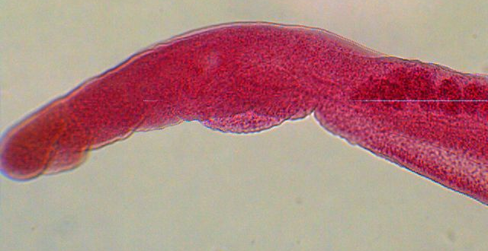
Male
Species | S. mansoni | S. japonicum
Size | 8x1 mm | 15xo.5 mm
Testes | 6-9 testes in cluster | 6-8 testes in a line
Cuticle | course tubercles | No tubercles

Slide 6
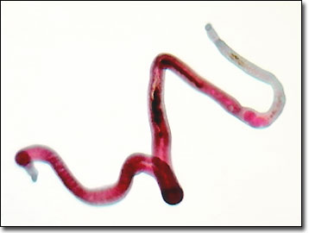
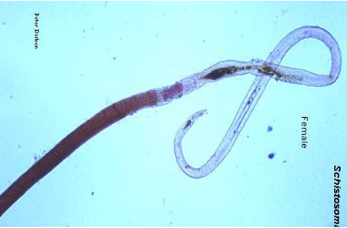
Female
Species | S. mansoni | S. japonicum
Size | 14x0.15 mm | 26x0.3 mm
Ovary | ovary ant. 1/3 | Ovary in the middle
Vitelline glands | vit. gl post 2/3 | Vit. gl. in post 1/2

Slide 7
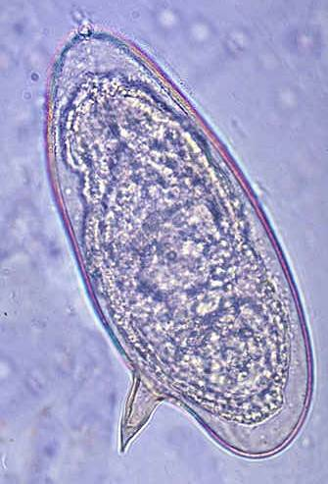
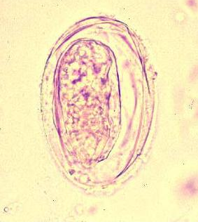
Egg
 | S. mansoni | S. japonicum
 | In stool
Size | 150x60 μ | 85x65 μ
Shape | Oval Lateral spine | Ovoid Minute knob
Shell | translucent, non operculated
Content | Mature embryo (miracidium)

Slide 8
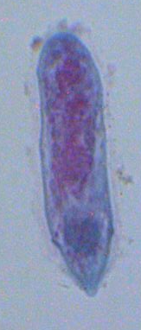
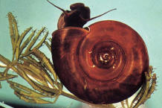
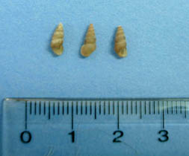
Miracidium
Snail I. H
S. mansoni
Biomphalaria alexandrina
S. japonicum
Oncomelania

Slide 9
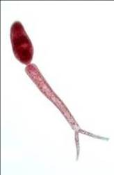
Infective stage (Cercaria):
Formed of body and forked tail (furcocercous)
5-6 pairs of penetration glands.
Skin penetration is aided by:
1-Proteolytic enzymes.
2-Surface tension of drying
water.
3-Movement of the tail

Slide 10
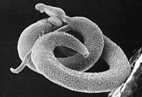
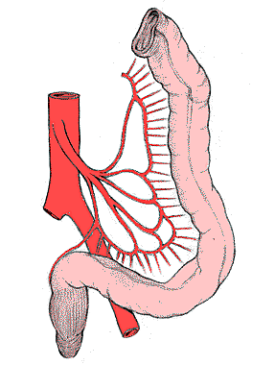
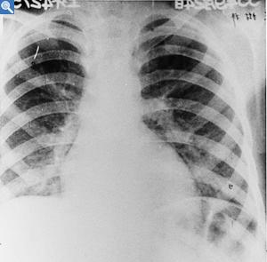
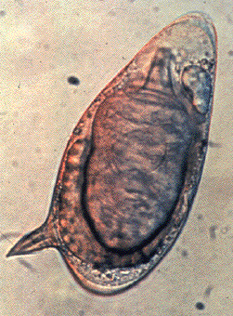
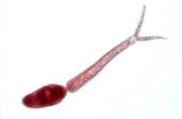
Worms mate in the liver
Worms in their habitat
Schistosomulum reaches circulation
Female lays eggs
Miracidium infects snail i.h.
Eggs in stools
Infection in contaminated water
Cercarial shedding
Miracidia hatch

Slide 11
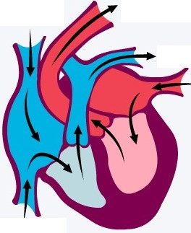
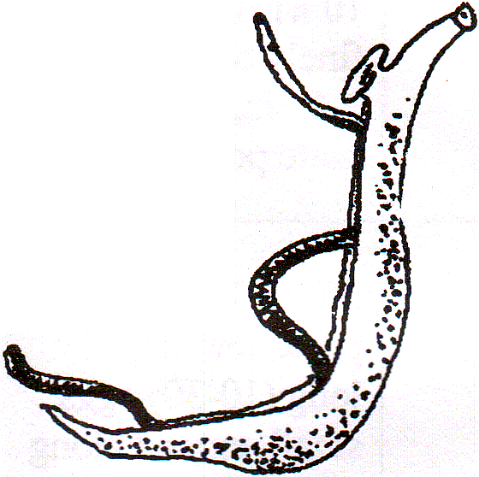
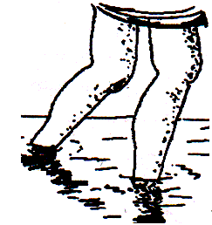
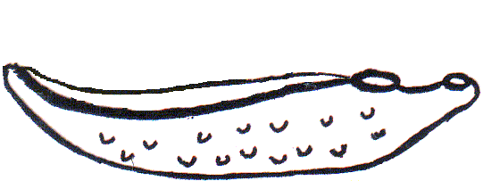
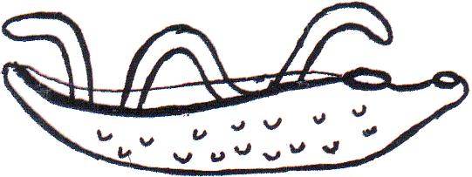
Development of Schistosoma inside the body of infected human
Aorta
II
Systemic circulation
Venous circulation
Liver
Schistosomula
♀
Vesical plexus
♂
I
S.haematobium
Portal vein
Inf. mesenteric plexus
Cercariae penetrates human skin
S.mansoni
III
IV
Direction of venous blood flow
In urine or stool

Slide 12
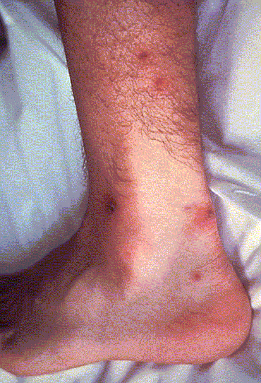
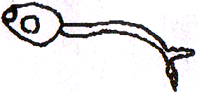
Pathogenesis and Clinical Picture
There are 4 progressive stages:
I- Stage of invasion
(1-4 days)
Local dermatitis, irritation.
Papular rash.

Slide 13
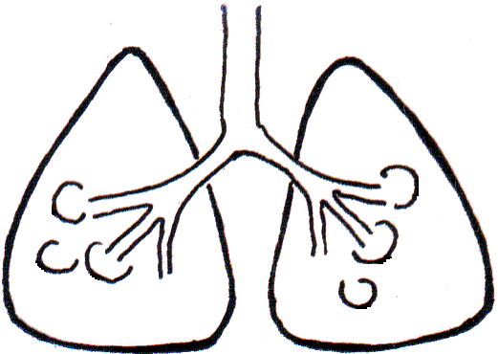
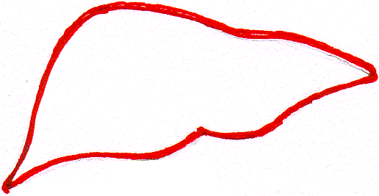
II- Stage of migration
(3-4 weeks)
By schistosomula
Metabolic products: toxic and allergic manifestations as
urticaria, fever, headache, muscle pain.
In the lung: verminous pneumonitis, minute haemorrhage
cough, haemoptysis.
In the liver: enlarged and tender.

Slide 14
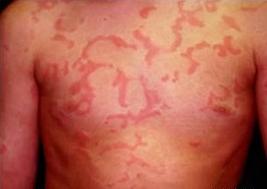
III- Stage of egg deposition and extrusion
(acute stage: 1-2 month)
A- Eggs are deposited in the venous plexus
The patient may complain of:
Generalized malaise, fever,
rigors, urticaria, abdominal pain
and liver tenderness.
Urticaria

Slide 15
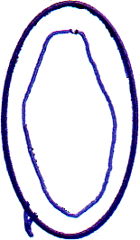
Katayama Syndrome
Occurs mainly in S.japonicum infection
Due to:
1- ♀lays large number of eggs
2- greater proximity to the liver
Soluble egg antigens are released in blood stream
immune complex
Circulate
Blood vessel
antibodies
Deposited in the tissues
Tissue damage
The patient suffers from:
Fever, chills, diarrhoea, generalized lymphadenopathy
Thus also called acute toxoemic schistosomiasis

Slide 16
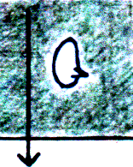
B- Stage of egg extrusion:
1-Pressure within the venule
2-Effect of the spine
Eggs escape from the veins to the perivascular tissue due to:
3-oozing lytic secretion of the miracidium within the egg
Damage & haemorrhage
S.mansoni & S.japonicum
In mesenteric plexus of veins
Egg extruded
Intestinal wall
Dysentery with blood and mucus in stool

Slide 17
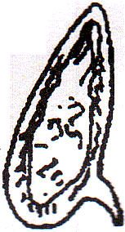
IV- Stage of tissue reaction (chronic stage)
(months – years)
Shell & miracidial antigens
Occurs around Schistosoma eggs deposited in various tissues.
Granuloma formation in tissue
Granuloma develops
Attract inflammatory cells
Deposition of fibrous tissue
miracidium
Damage of affected organ and its fibrosis
Inflammatory cells
Egg shell
Delayed-type hypersensitivity
Loss of its function

Slide 18
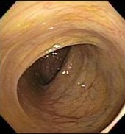
IV- Stage of tissue reaction (chronic stage)
In S.mansoni infection
Eggs fail to fix to venule wall are swept by blood
3
Normal mucosa of colon
2
Eggs trapped in Intestinal wall
1
Eggs extruded in stool
Polyps in the colon in S.mansoni infection
Cause Embolic lesions

Slide 19
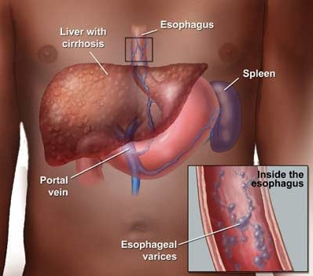
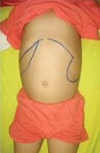
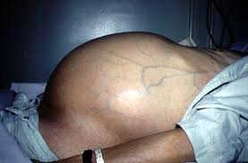
Embolic Lesions in the Liver
Portal hypertension
Hepatosplenomegaly
Oesophageal varices
Ascites.

Slide 20
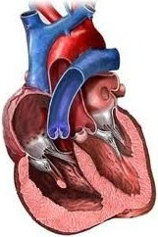
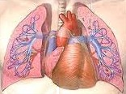
Embolic Lesions in the lung
Bilharzial cor-pulmonale
Pulmonary hypertension
In Schistosoma infection
In Normal condition
Trapped eggs
Dilated right ventricle
Thickened wall
Enlarged right ventricle
Cor-pulmonale = right-sided heart failure
Means: enlargement of right ventricle due to high blood pressure in the arteries of the lung
Embolic lesions may occur in any other organ.

Slide 21
Diagnosis of Schistosomiasis
Clinically
Laboratory
Radiological imaging
Endoscopy
(suggestive)
1- History of contact with infected water.
1- Detection of eggs in stool
2- Clinical picture according to stage of infection.
2- Blood examination
3- Serological tests

Slide 22
I- Laboratory Diagnosis
1- Direct parasitological methods:
- Detection of S.mansoni eggs in stool by direct smear method or by concentration method.
- Kato thick faecal smear: for egg counting to assess the intensity of infection
- Rectal swab

Slide 23
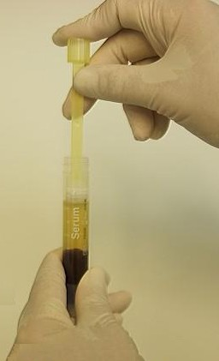
I- Laboratory Diagnosis
2- Blood examination:
1- Egg extrusion
Iron deficiency anaemia
Anaemia due to
2- Hypersplenism
Eosinophilia, leucocytosis.
Haemolytic anaemia
3- Serological Tests:
(Immunodiagnostic Tests)
Detection of anti-Schistosoma antibodies or antigen in patient’s serum
a- IHAT (Indirect Haemagglutination test)
Sensitized sheep RBCs
Latex particles
+ve
-ve

Slide 24
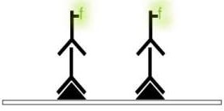
b- ELISA (Enzyme-linked immunosorbent assay)
Coating with Schisto Ag
Patient’s serum
Ab linked to enzyme
substrate
Ab detected
wash
wash
wash
Coating with anti-Schisto MAb
Patient’s serum
Ab linked to enzyme
substrate
Ag detected
wash
wash
wash
c- IFAT (Indirect Fluorescent Antibody test)
Patient serum
Ab detected
Schisto Ag
wash
wash

Slide 25
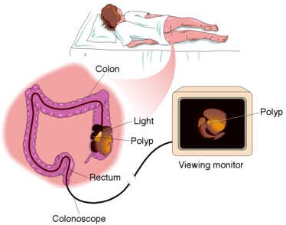
II- Radiological imaging
المناظير III- Endoscopy
S.mansoni infection
Colonoscopy, sigmoidoscopy in S.mansoni
Intestinal affection
Done in chronic cases to detect lesions and take biopsies

Slide 26
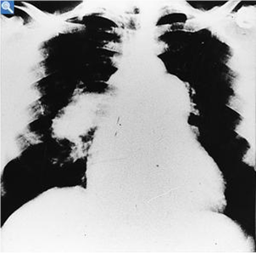
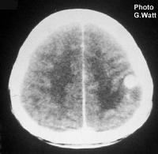
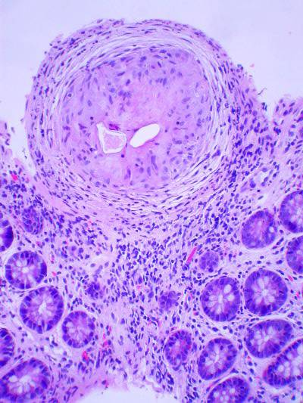
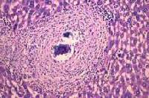

Slide 27
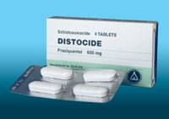
Treatment
Praziquantel (Biltricide):
For all schistosome species.
Dose:40 mg/kg single oral dose
Oxamniquine (vancil):
For S. mansoni
Dose: 30 mg/kg for 2 days

Slide 28
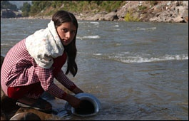
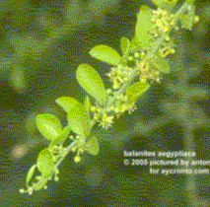
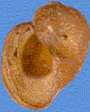
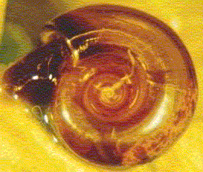
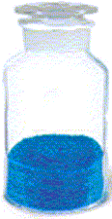
Prevention and Control
- Mass treatment.
- Health Education.
- Snail control:
Physical methods
Biological methods
Chemical methods
X
Balanites aegyptica
Copper sulphate

Slide 29
Cercarial Dermatitis (Bather’s itch)
A condition that occurs due to penetration of cercariae of non-human species of schistosomes the skin of man.
Cercariae cannot go beyond the germinal layer.
Clinical picture:
Dermatitis, itching, oedema and secondary bacterial infection.
Treatment:
Antipruritics, antihistamincs,
antibiotics.

